Slide 1
Automated Cheque Processing
An interactive and user friendly model with high level of security and reliability

Slide 2
Project Description
We have tried to build an model where whole process of verifying cheque is significantly reduced without compromising security and privacy .
Model is going to process cheque which include signature verification, voice verification, and use optical character recognition to fetch data from the cheque and do entry in the database automatically.

Slide 3
Solution Diagram
Scan Image
Automatic Data Entry
Extraction Of Data and Signature
Performance Evaluation
Verification of Signature

Slide 4


Tools and Technology used
Microsoft Services | Other Services
Azure Form Recognizer | Pytorch Model For signature Verification
Azure Custom Object Detection | Flask API
Azure SQL Database | Django Framework

Slide 5
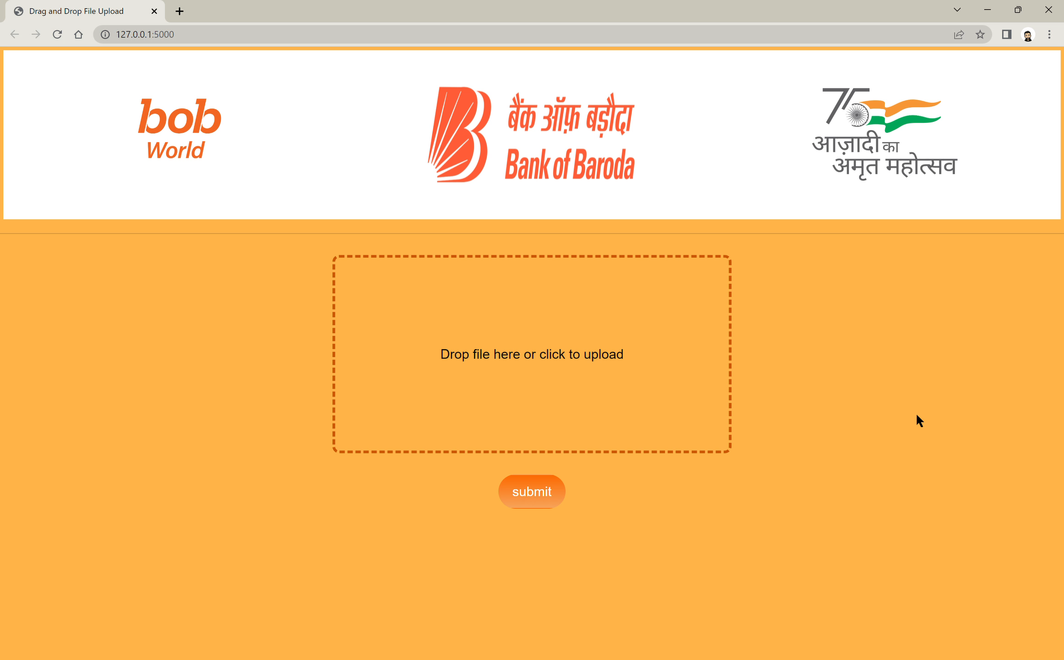
Demo Video

Slide 6
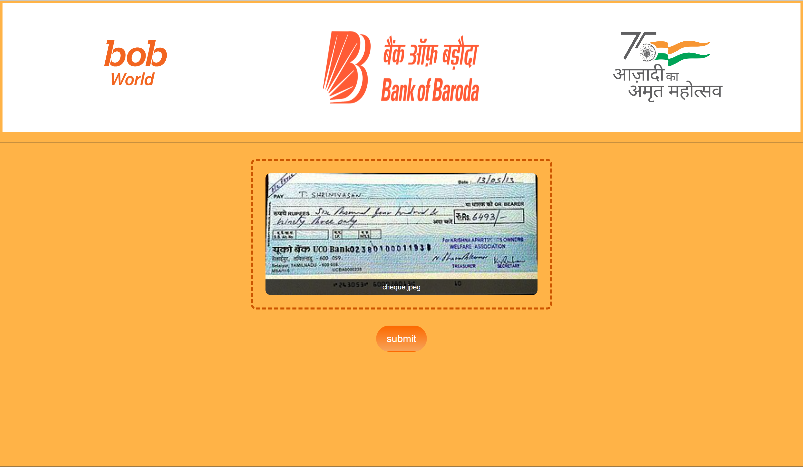
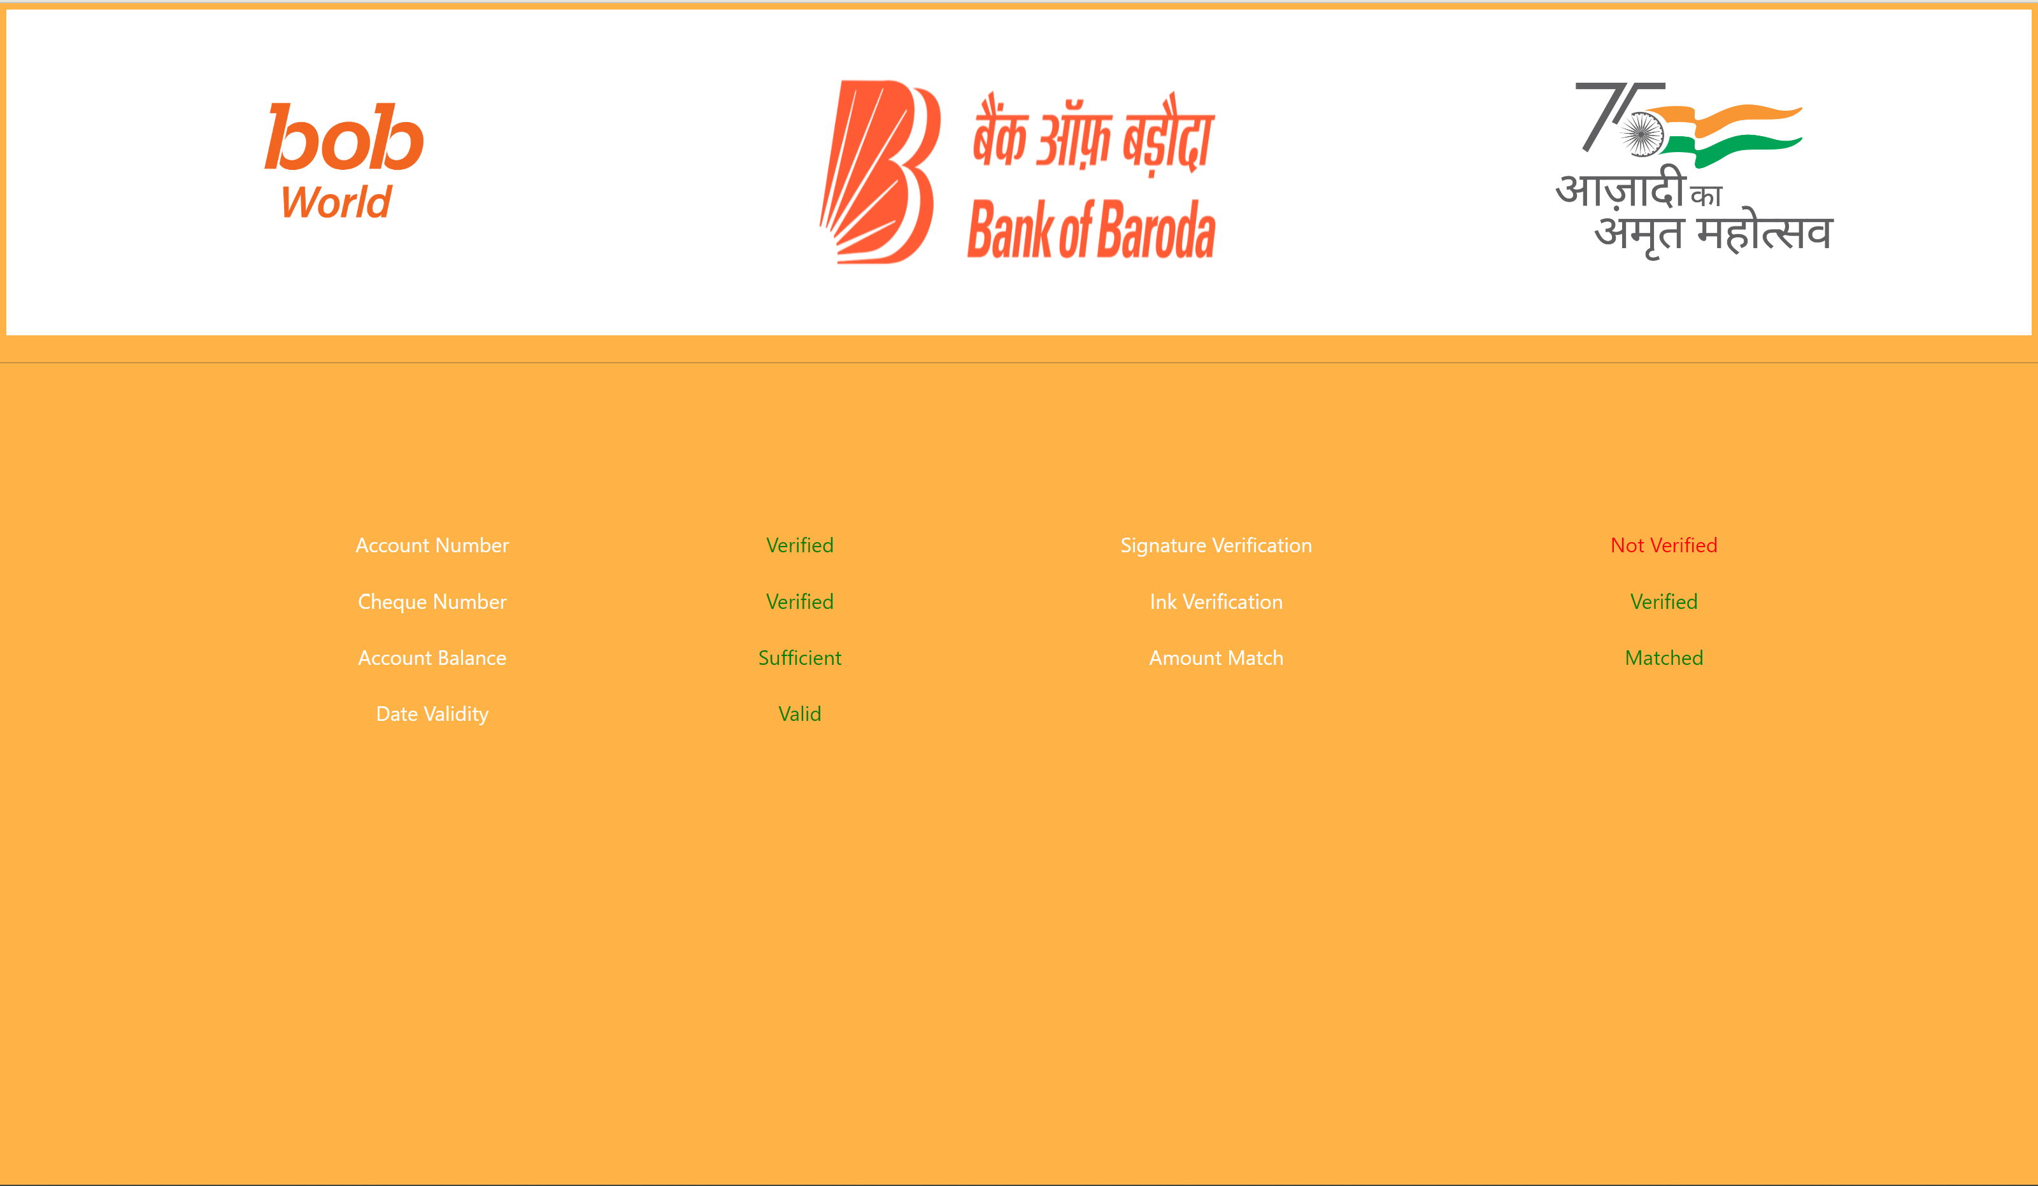
Test case and its output
As shown above our model is correctly predicting Account No. , Cheque No. , matches if account has sufficient amount, check if Date is within range and cheque is not expired etc.
As per our trained dataset of signature this cheque signature is not matching upto threshold limit.

Slide 7

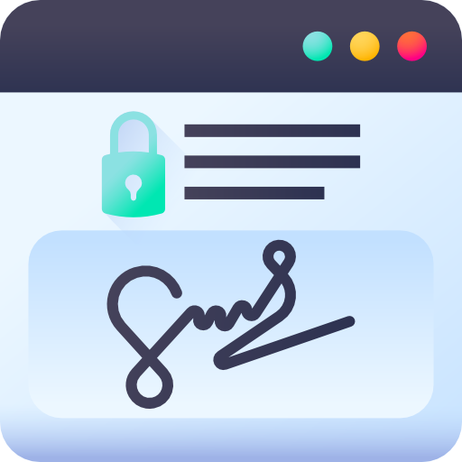


What's make Our idea Different
Voice Detection | Signature Verification
Multicolor Ink detection | Date Validation

Slide 8
Scope to scale Up
Whole idea can have hardware implementation possible and extra level of security can be included with high tech cameras and tools
Other bank’s are also interested to include this idea to their bank
This feature can be integrated with BOB World app for fast online service without intervention of bank
Hardware model can be integrated with ATMs for less hassle in bank

